Slide 1
Virtual mouse using OpenCV

Slide 2
Introduction
With the development technologies in the areas of augmented reality and devices that we use in our daily life, these devices are becoming compact in the form of Bluetooth or wireless technologies.
This paper proposes an virtual mouse system that makes use of the hand gestures and hand tip detection for performing mouse functions in the computer using computer vision.
The main objective of the proposed system is to perform computer mouse cursor functions and scroll function using a web camera or a built-in camera in the computer instead of using a traditional mouse device.
Hand gesture and hand tip detection by using computer vision is used as a HCI with the computer. With the use of the virtual mouse system, we can track the fingertip of the hand gesture by using a built-in camera or web camera and perform the mouse cursor operations and scrolling function and also move the cursor with it.

Slide 3
abstract
The proposed virtual mouse system can be used to overcome problems in the real world such as situations where there is no space to use a physical mouse and also for the persons who have problems in their hands and are not able to control a physical mouse.
Also, amidst of the COVID-19 situation, it is not safe to use the devices by touching them because it may result in a possible situation of spread of the virus by touching the devices, so the proposed virtual mouse can be used to overcome these problems since hand gesture and hand Tip detection is used to control the PC mouse functions by using a webcam or a built-in camera.

Slide 4
methodology
MediaPipe is a framework which is used for applying in a machine learning pipeline. The MediaPipe framework is multimodal, where this framework can be applied to various audios and videos.
Single-shot detector model is used for detecting and recognizing a hand or palm in real time. The single-shot detector model is used by the MediaPipe.
OpenCV is a computer vision library which contains image-processing algorithms for object detection .

Slide 5
-OpenCV
-MediaPipe framework
-VScode
-Windows11

Slide 6
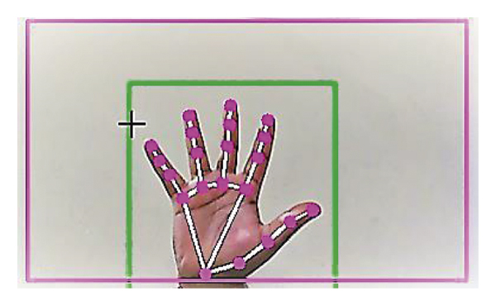

Slide 7
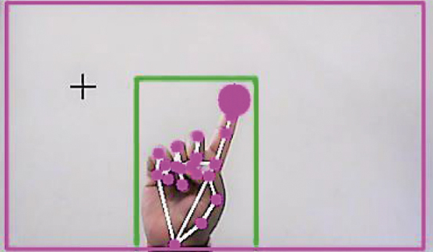

Slide 8
THANK YOU
Y.AMBIKA​
P.SNEHA
K.MAHESHWARI
R.THARUN

